Slide 1
Touch panel experiment
Loretta Black
&
Lindsey Renken

Slide 2
Experimental design
Before starting – coat touch panel with poly-l-lysine and attach well system
Step 1: Blank with well system attached (#1)
Step 2: Add 30 µl Hyclone water to each well and measure again (#2)
Step 3: Add probe molecules to most of the wells and incubate
Measure before (#3) and after (#4) incubation
Step 4: Wash, dry, & measure (#5)
Step 5: Add 30 µl Hyclone water to each well and measure (#6)
Step 6: Add target molecules to some of the wells and incubate at 42°C overnight
Measure (#7)
Step 7: Add 30 µl Hyclone water to each well and measure (#8)
*Record temperature for each measurement

Slide 3
Touch panel layout
KEY
probes + targets
probes
control
Measurement # | Temperature (°C)
1
2
3
4
5
6
7
8

Slide 4
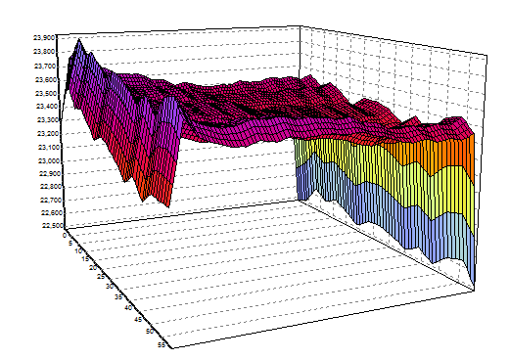
Step 1: Blank

Slide 5
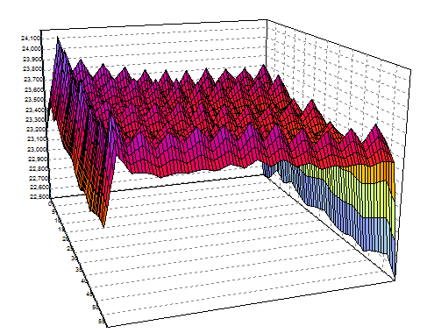
Step 2: Hyclone water all wells

Slide 6
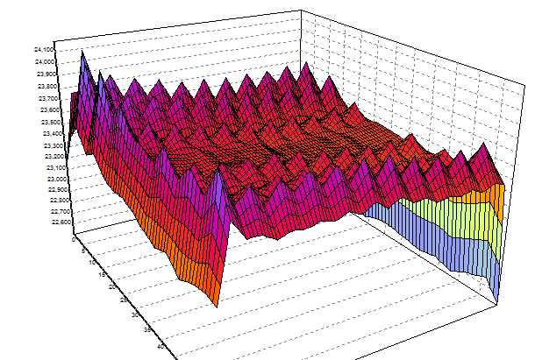
Step 3: Probe molecules in solution

Slide 7
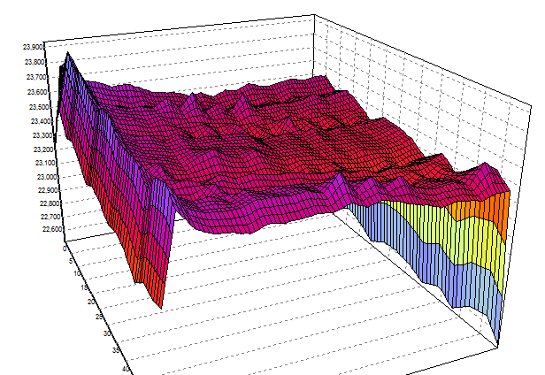
Step 4: Wash, dry, measure

Slide 8
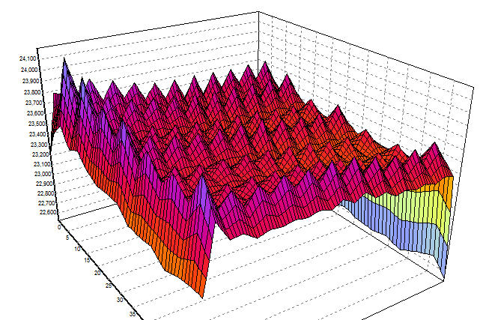
Step 5: Add hyclone water all wells

